Slide 1
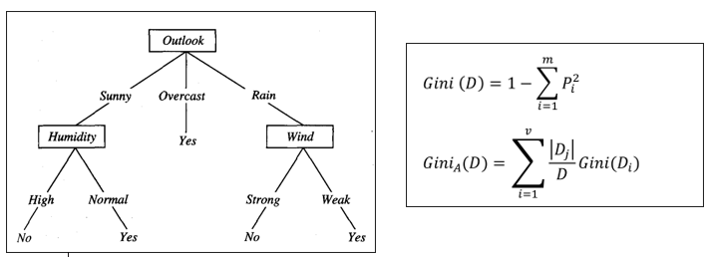
Decision Tree
criterion{“gini”, “entropy”}, default=”gini”

Slide 2
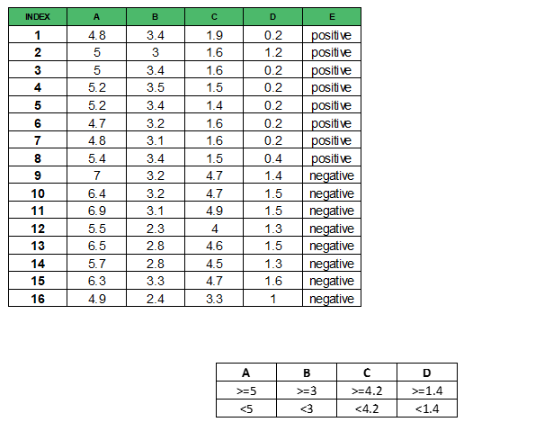
Decision Tree
Dataset Contoh
https://www.geeksforgeeks.org/decision-tree-introduction-example/

Slide 3
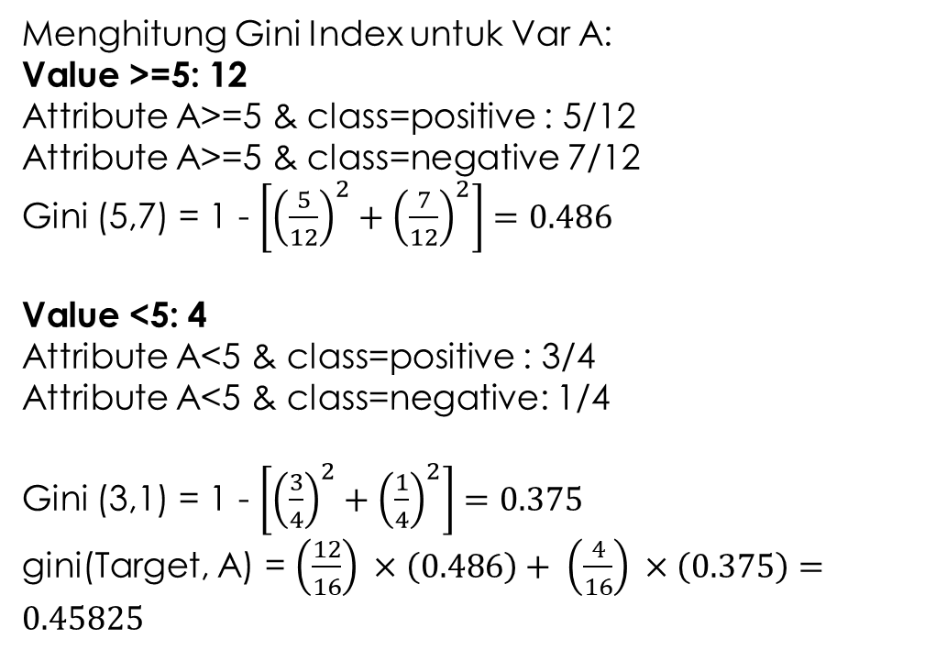
Decision Tree
Menghitung Gini Index untuk Var A:
Value >=5: 12
Attribute A>=5 & class=positive : 5/12
Attribute A>=5 & class=negative 7/12
Gini (5,7) = 1 - $\left[{\left(\frac{5}{12}\right)}^{2}+{\left(\frac{7}{12}\right)}^{2}\right]=0.486$
Value <5: 4
Attribute A<5 & class=positive : 3/4
Attribute A<5 & class=negative: 1/4
Gini (3,1) = 1 - $\left[{\left(\frac{3}{4}\right)}^{2}+{\left(\frac{1}{4}\right)}^{2}\right]=0.375$
gini(Target, A) = $\left(\frac{12}{16}\right) ×\left(0.486\right)+ \left(\frac{4}{16}\right) ×\left(0.375\right)=0.45825$

Slide 4
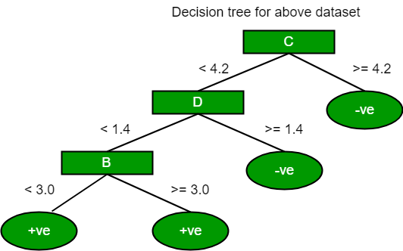
Decision Tree Hasil perhitungan Gini Index
Gini index of C = 0.2

Slide 5
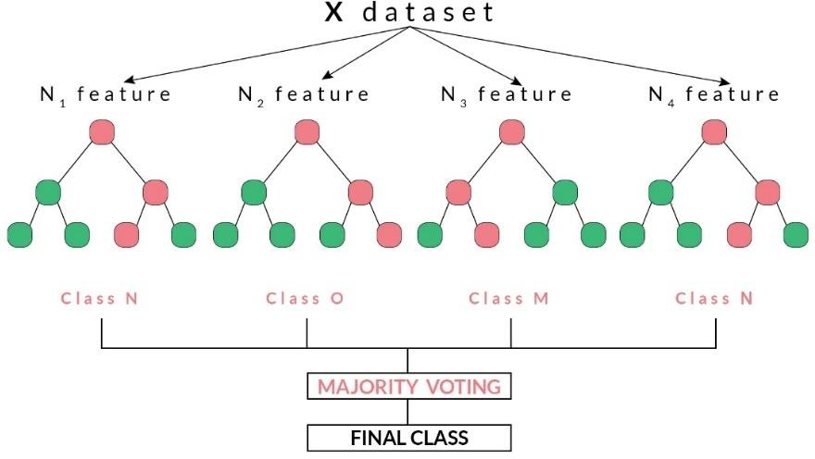
Random Forest
Random Forest memiliki beberapa decision tree, kemudian algoritma Random Forest mengambil keputusan berdasarkan hasil voting terbanyak dari semua decision tree.

